Slide 1
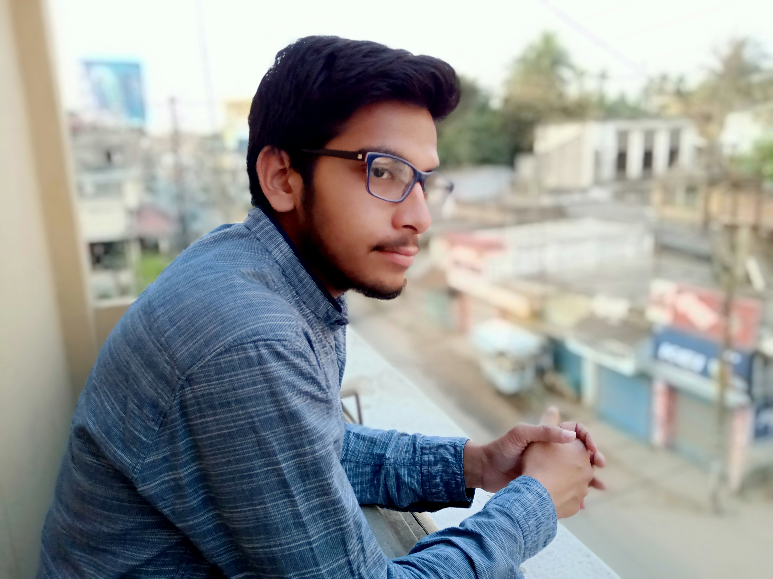


Hello, This is Shubham Dutta
UEMK
Trainer @IEMLABS
Ex-Full Stack Web Developer@Quordnet Academy | SWE Freelancer @OYO
Founder Member of startup “The Clever World”
Open Source Contributor
Shubhamdutta2000
shubham--dutta

Slide 2


Course Content
Introduction to Web Development HTML CSS with Web Design Bootstrap and other styling Framework Git and GitHub JavaScript jQuery Firebase PHP Database (SQL vs NoSQL) | Database (SQL) WordPress Node with Express EJS React Angular Vue Other Concepts(Devops, Personal hosting,native apps etc,etc) Projects
Shubham_dutta15

Slide 3
What is Web Development ?
Notes:
So what would you do with it? We are here to help you answer that question
Lets start with a brief introduction about Technobuzz.
It’s a workshop series to help you shape your career and decide a career path. It will also help you understand how technology can help your business.
We will first cover an introduction to a field of technology which is for today, Cloud Computing, and discuss career opportunities available in the field and we’ll provide you with the learning resources for you to move forward after this session. We will have a hands-on session tomorrow for more concrete understanding of what you learn today.
Enough of Technobuzz, now lets dive into cloud computing

Slide 4

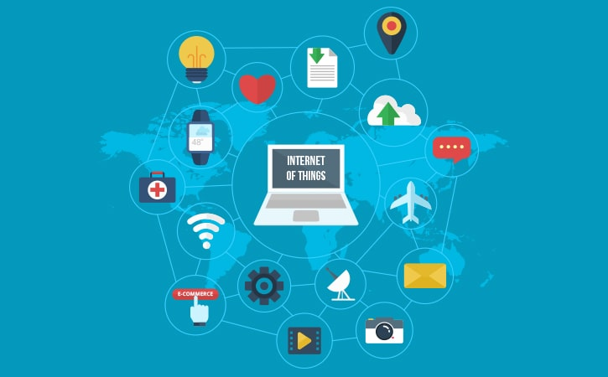
What is Web Development?
Web development is the work involved in developing a
Web site for the Internet (World Wide Web) or an intranet
(a private network).^{[1]} Web development can range
from developing a simple single static page of plain text to complex web applications, electronic businesses,
and social network services.

Slide 5
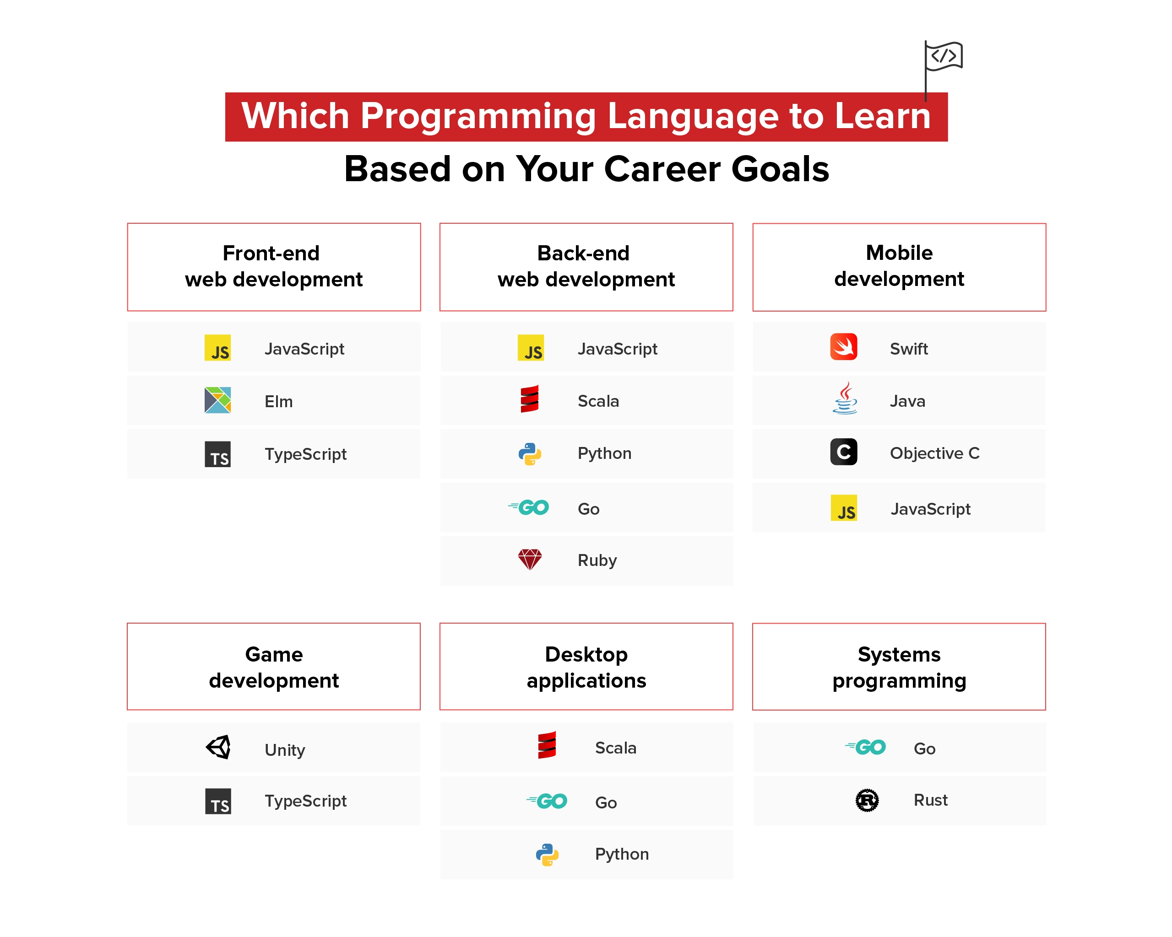
Web Career Goals

Slide 6

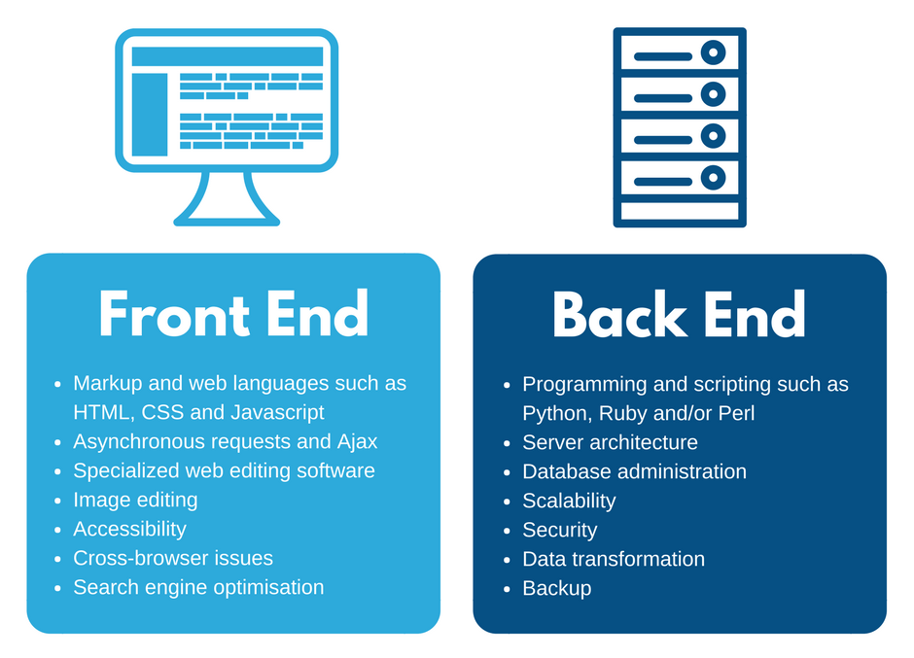
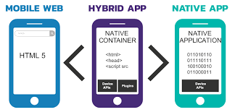






Who are full stack developers ? (5+ years)

Slide 7
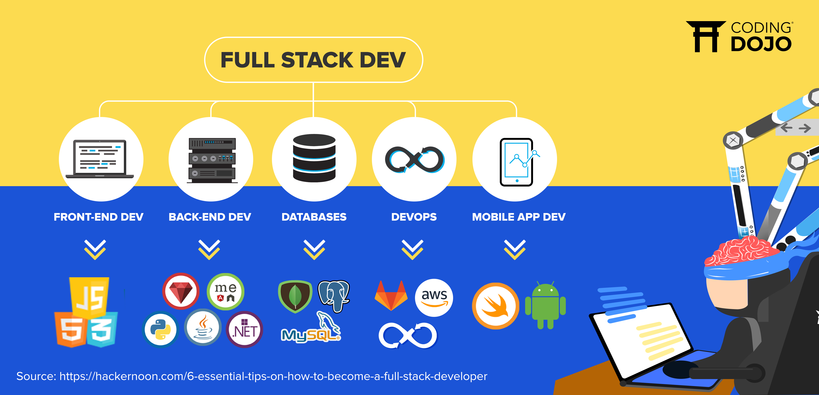

Slide 8
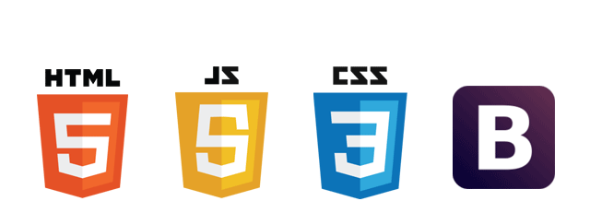
Frontend Components

Slide 9
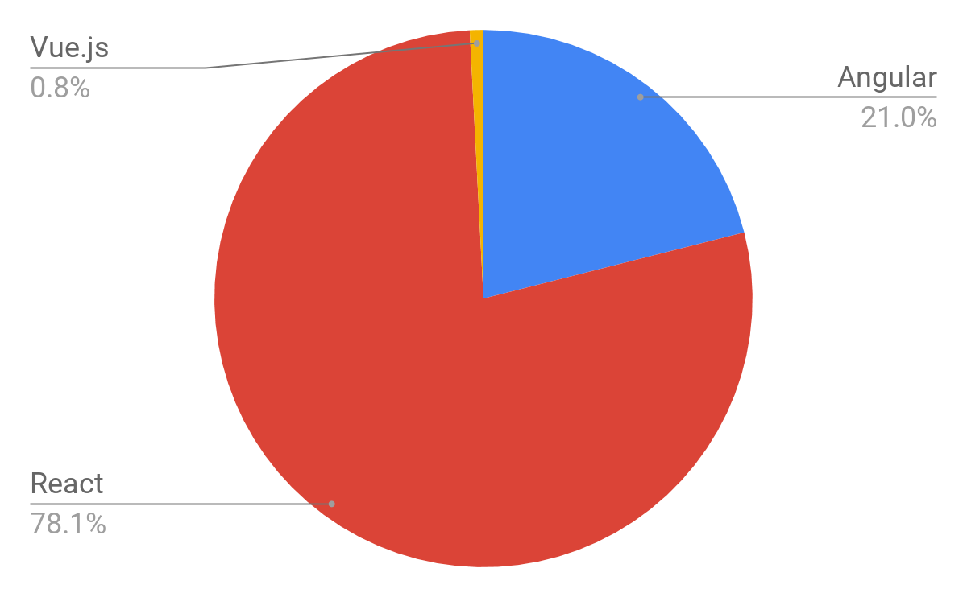

Slide 10
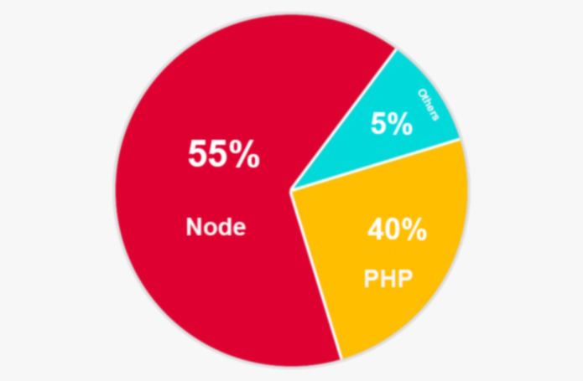
Backend Market Trend

Slide 11
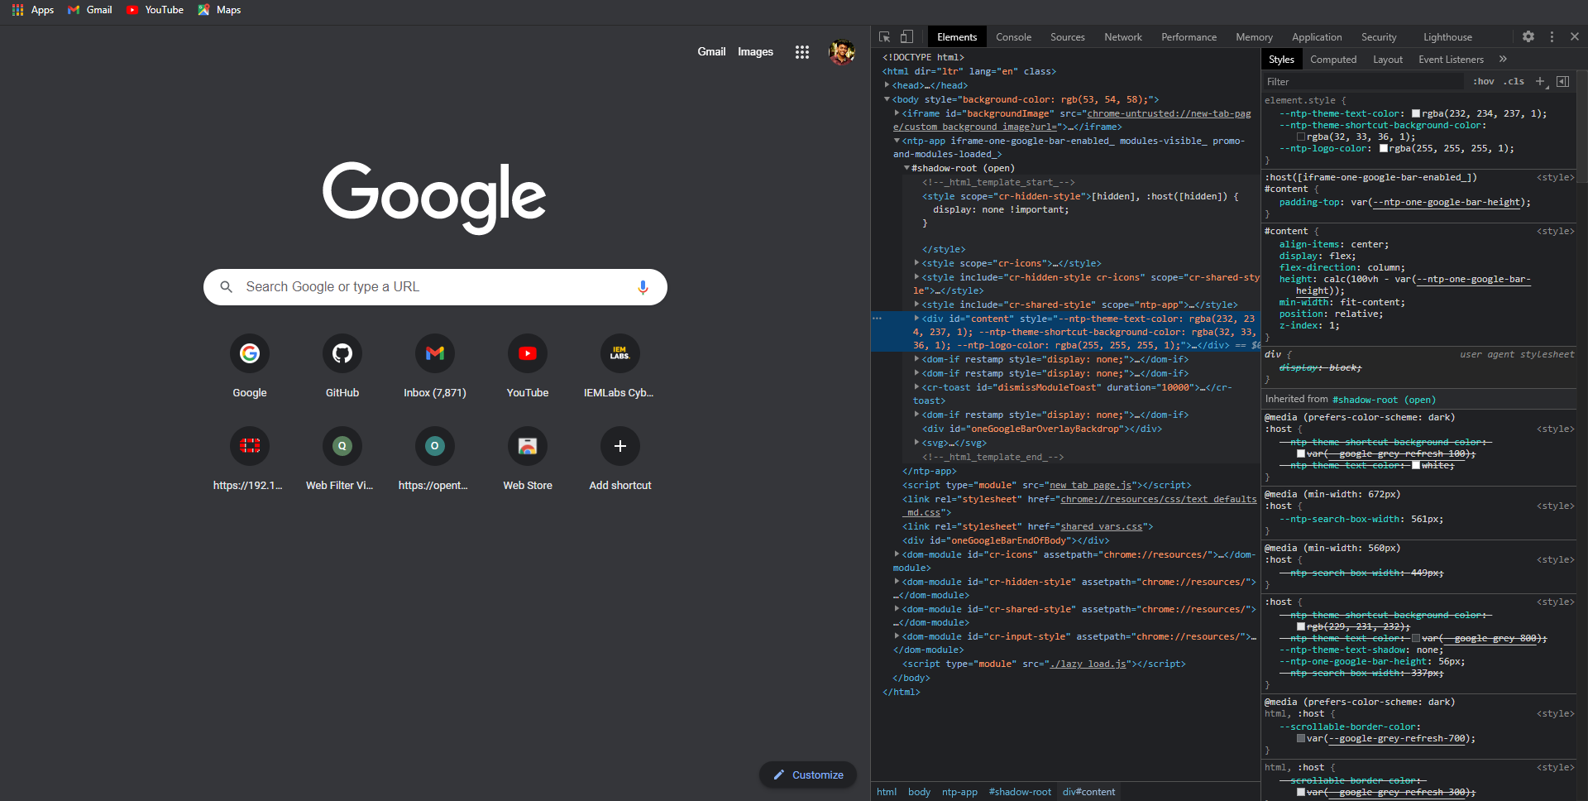
Chrome Dev Tools
Chrome DevTools is a set of web developer tools built directly into the Google Chrome browser.DevTools can help you edit pages on-the-fly and diagnose problems quickly, which ultimately helps you build better websites, faster.

Slide 12











Slide 13
What’s Next?
Do some Hands-On

